Slide 1
Instrumented & Monitored Order API
Theo Boyesen
Ironhack – Cloud Engineering
Individual Project

Slide 2
Project Goals
Goal: Build a production-style observable system
Key components:
Structured logging
Custom metrics
CloudWatch dashboards
Automated alerting
Incident simulation
The goal of this project was not just to build an API, but to make it observable and maintainable.
I implemented structured logging, custom metrics, monitoring dashboards, automated alerts, and simulated incidents to validate the monitoring system.

Slide 3
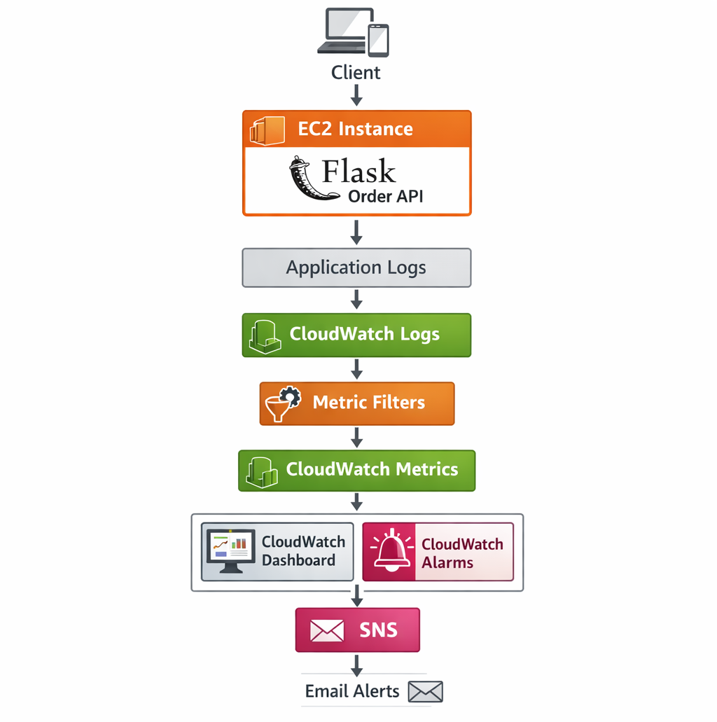
System Architecture
Flask API running on EC2
CloudWatch collects logs and metrics
Dashboards visualize system health
Alarms detect failures
SNS sends notifications
The system is deployed on an EC2 instance running a Flask API.
Application logs are forwarded to CloudWatch Logs.
Metric filters extract custom metrics.
These metrics are visualized in a CloudWatch dashboard.
When thresholds are exceeded, CloudWatch alarms trigger SNS notifications.

Slide 4
Application Instrumentation
Structured JSON logging
Request correlation IDs
Latency instrumentation
Log levels (INFO, WARN, ERROR)
The application uses structured JSON logging, which makes logs easier to search and analyse.
Each request includes a unique request ID so logs related to the same request can be traced.
I also instrumented latency measurement so we can track API performance.

Slide 5
Custom Metrics
Metrics extracted from logs using metric filters
orders_created_total
orders_retrieved_total
api_errors_total
request_latency_ms
Custom metrics were generated from application logs using CloudWatch metric filters.
This allows application behaviour to be monitored in real time without modifying the infrastructure layer

Slide 6
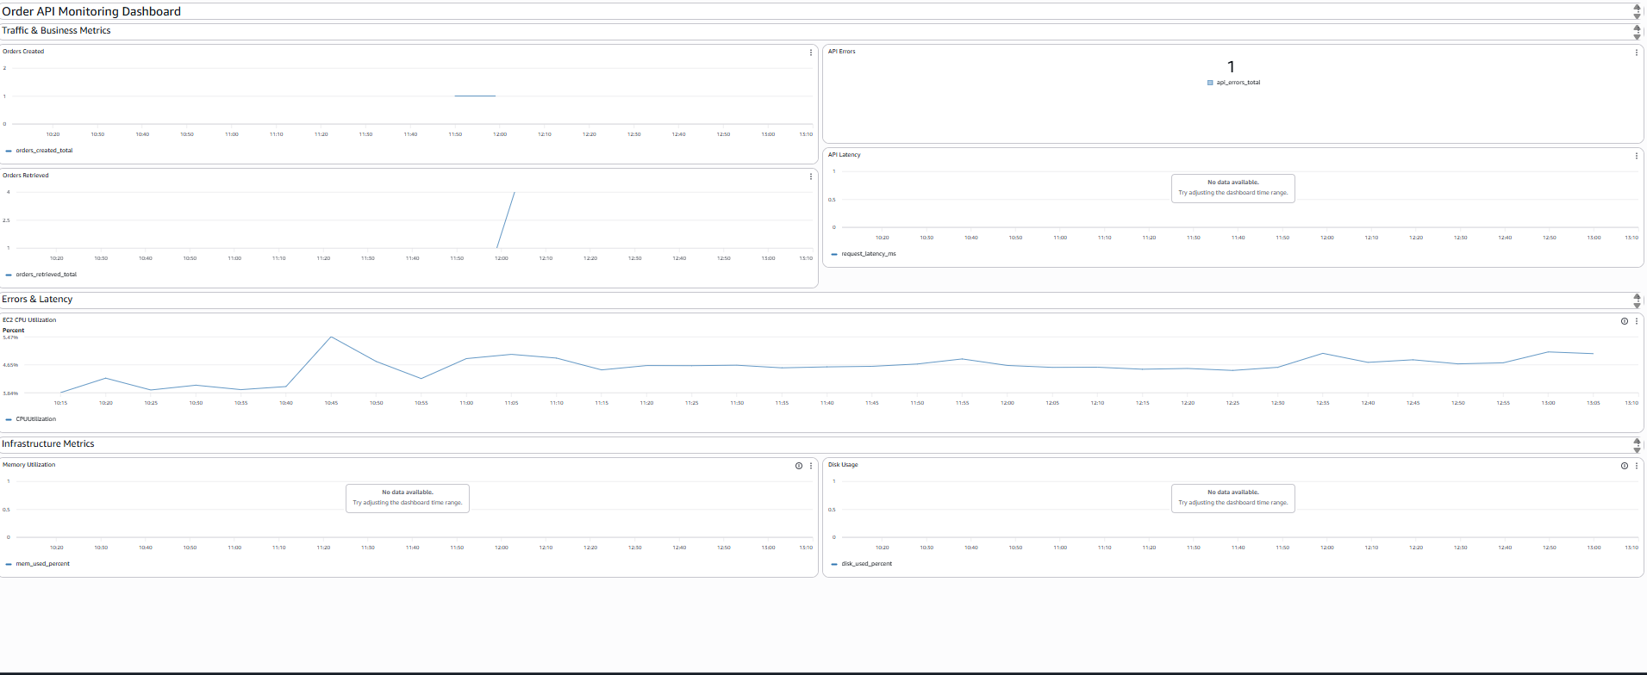

Slide 7
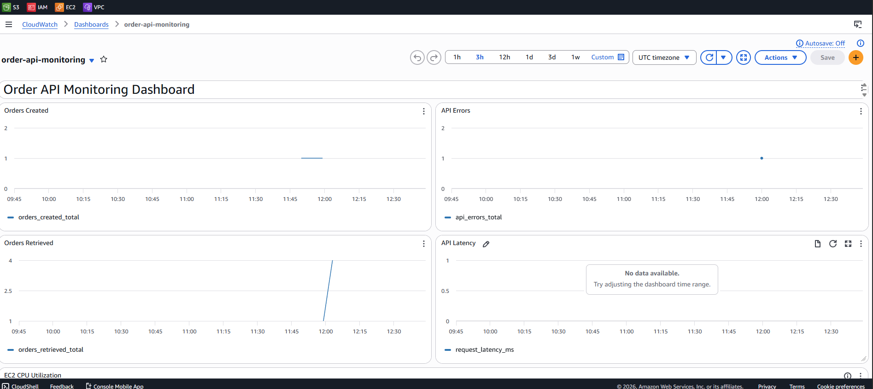
Monitoring Dashboard
Dashboard designed using Golden Signals
Traffic
Errors
Latency
Saturation
The monitoring dashboard was designed using the Golden Signals model from Google SRE.
This approach focuses on the four most important indicators of system health.

Slide 8
Golden Signals Implementation
Traffic → orders_created_total
Errors → api_errors_total
Latency → request_latency_ms
Saturation → CPU, Memory, Disk
Each signal is represented by a specific metric.
Together these provide a complete view of system health.

Slide 9
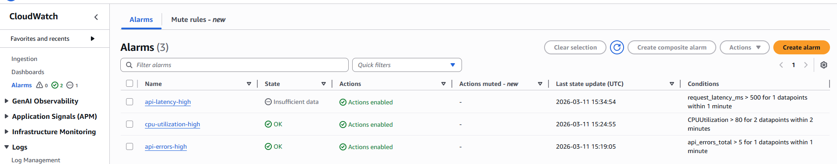
Automated Alerting
Three CloudWatch alarms configured
api-errors-high
cpu-utilization-high
api-latency-high
Automated alerts were implemented using CloudWatch alarms.
These alarms monitor error rates, latency, and infrastructure resources.

Slide 10
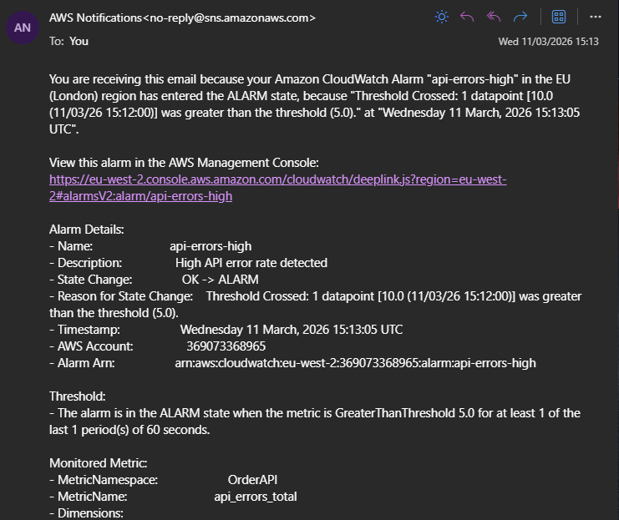
Alert Notifications
CloudWatch alarms
→ SNS topic
→ Email notifications
When an alarm triggers, CloudWatch sends a notification
through SNS.This ensures operators are immediately
informed of system issues.

Slide 11
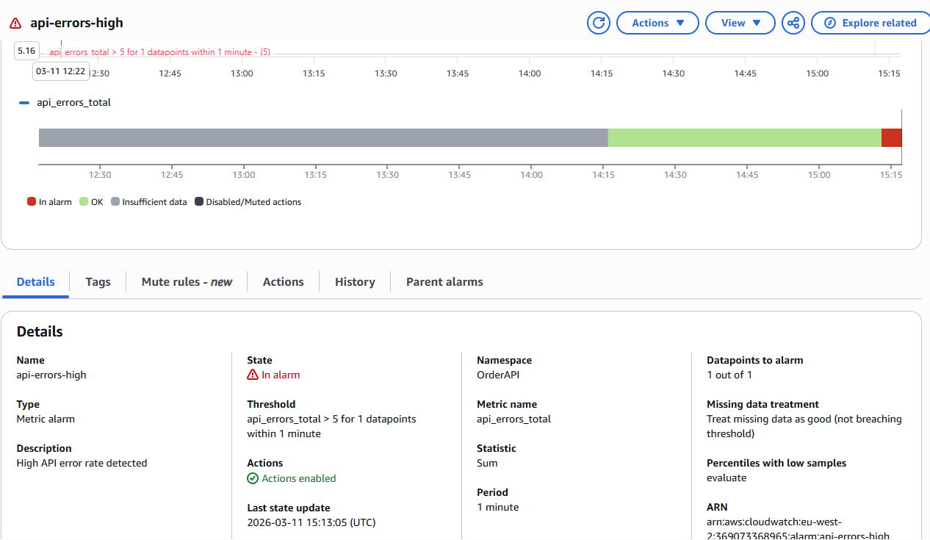
Incident Simulation
Simulated production incidents
High CPU utilization
API error spike
To validate the monitoring system, I simulated two incidents:
a CPU saturation event and an API error spike.

Slide 12
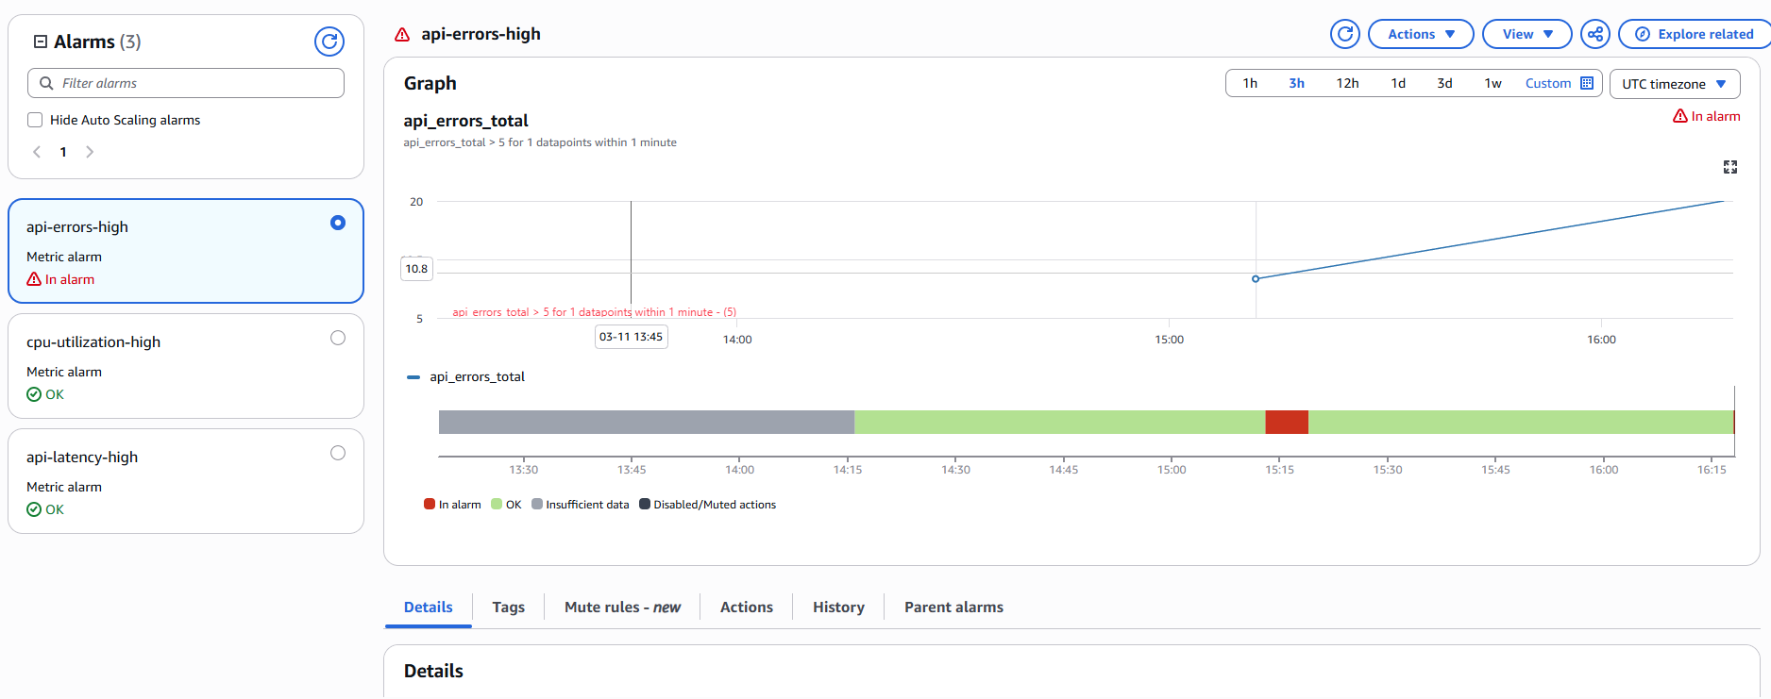
Incident Investigation
Monitoring data used to diagnose issues
CPU spike → resource saturation
Error spike → invalid API requests
The dashboard and logs made it easy to diagnose the root cause of each incident.

Slide 13
Key Learnings
Observability is essential for production systems
Structured logs enable metric extraction
Golden Signals simplify monitoring
Alerting enables rapid incident detection
This project demonstrated how observability tools allow engineers to quickly detect and diagnose system problems.

Slide 14
Future Improvements
Distributed tracing (AWS X-Ray)
Auto-remediation using Lambda
Load testing and performance benchmarking
Scaling with Auto Scaling Groups
There are several ways this system could be expanded to be more production ready.

